Slide 1
8086 Memory Address Space Partition
And
Addressing Modes
Course Teacher:
Md. Motaharul Islam, PhD
Associate Professor
Department of Computer Science & Engineering
BRAC University.
Course ID: CSE341
Course Title: Microprocessors

Slide 2
Lecture References:
Book:
  Microprocessors and Interfacing: Programming and Hardware, Chapter # 2, Author: Douglas V. Hall
  The 8086/8088 Family: Design, Programming, And Interfacing, Chapter # 2, Author: John Uffenbeck.
CSE – 341 : Microprocessors
BRAC University

Slide 3
Memory Partitioning for 8086 Processor
The 8086 processor assign a 20-bit physical address to its memory locations.
    2²⁰ → 1 Mbyte
    20 bits → 5 hex digits
    First addresses: 00000, 00001,…,0000A,…FFFFF.
    But Registers are 16-bits and can address only 2¹⁶ = 64 KBytes.
Partition the memory into segments
  One way four (4) 64 Kbytes segments might be positioned within the 1 Mbyte address space of an 8086 processor.
CSE – 341 : Microprocessors
BRAC University

Slide 4
Memory Segment: Address Space
Memory segment is a block of 2¹⁶ (64) KBytes consecutive memory bytes.
Each segment is identified by a 16-bit number called segment number, starting with 0000 up to FFFFh. Segment registers hold segment number.
Within a segment, a memory location is specified by giving an offset (16-bit) = It is the number of bytes from the beginning of the segment (0→ FFFFh).
CSE – 341 : Microprocessors
BRAC University

Slide 5
Memory Segment: Address Space
F0000
FFFF0 To FFFFF
is reserved for
ROM (16 bytes)
E0000
D0000
C0000
B0000
A0000
90000
8000:FFFF
80000
One Segment
8000:0000
70000
60000
50000
segment
offset
40000
00000 to 3FFFF
is reserved in
RAM to load
system function
30000
20000
10000
00000
CSE – 341 : Microprocessors
BRAC University

Slide 6
Memory Segment: Address Space
A memory location may be specified by a segment number and offset ( logical address ).
  Example :
A4FB : 4872
h
Offset: is the distance from the beginning to a particular location in the segment.
Segment Number: defines the starting of the segment within the memory space.
Segment
Offset
CSE – 341 : Microprocessors
BRAC University

Slide 7
Segmented Memory Location
one segment
linear addresses
CSE – 341 : Microprocessors
BRAC University

Slide 8
Segmented Memory Address
Start location of the segment must be 20 bits → the absolute address is obtained by appending a hexadecimal zero to the segment number, i.e. , multiplying by 16(10_{h}).
  Adds 4 Nibble bits at the lower portion of each 16-bit address.
So, the Physical Memory Address is equal to:
Physical Address = Segment number X 10_{h} + Offset
Physical Address for A4FB : 4872
A4FB0 h
+ 4872 h
A9822 h (20 Bits)
CSE – 341 : Microprocessors
BRAC University

Slide 9
Physical Location of Segments
Segment 0
  starts at address 0000:0000 → 00000 h
  ends at address 0000:FFFF → 0FFFF h
Segment 1
  starts at address 0001:0000 → 00010 h
  ends at address 0001:FFFF → 1000F h
Overlap occurs between the Segment 0 and 1.
  Advantage: Utilization of memory would be higher.
CSE – 341 : Microprocessors
BRAC University

Slide 10
Physical Location of Segments
Segment Physical Address (hex)
…
10021
10020
End of Segment 2 1001F
1001E
…
10010
End of Segment 1 1000F
1000E
…
10000
End of Segment 0 0FFFF
0FFFE
…
00021
Start of Segment 2 00020
0001F
…
00011
Start of Segment 1 00010
0000F
…
00003
00002
00001
Start of Segment 0 00000
CSE – 341 : Microprocessors
BRAC University

Slide 11
Addressing Mode and It’s Categories
The different ways in which a microprocessor can access data are referred to as its addressing modes.
Addressing modes of 8086 Microprocessor are categorized as:
  Addressing Data
  Addressing Program codes in memory
  Addressing Stack in memory
  Addressing I/O
  Implied addressing
CSE – 341 : Microprocessors
BRAC University

Slide 12
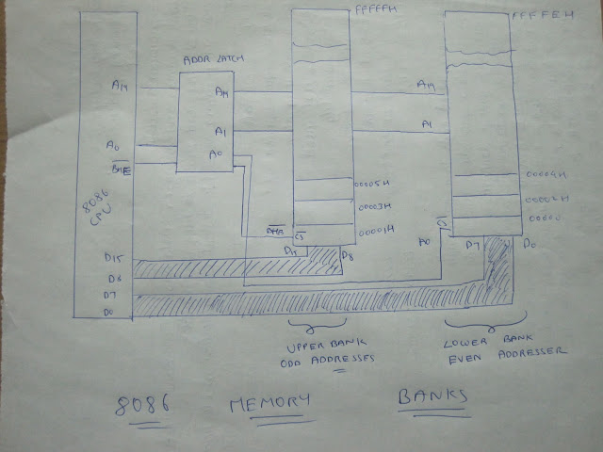
8086 Memory Banks

Slide 13
1. Addressing Data
Immediate addressing
Direct addressing
Register [direct] addressing
Register indirect addressing
Base-plus-index addressing
Register relative addressing
Base-relative-plus-index addressing
CSE – 341 : Microprocessors
BRAC University

Slide 14
1. Addressing Data
Immediate addressing
  Data is immediately given in the instruction
  MOV BL, 44
Direct addressing
  Data address is directly given in the instruction
  MOV BX, [437AH]
CSE – 341 : Microprocessors
BRAC University

Slide 15
1. Addressing Data
Register [direct] addressing
  Data is in a register (here BX register contains the data)
MOV AX, BX
Register [indirect] addressing
  Register supplies the address of the required data
MOV CX, [BX]
JMP [DI]
CSE – 341 : Microprocessors
BRAC University

Slide 16
1. Addressing Data
Base-plus-index addressing
  Base register is either BX or BP
  Index register is either DI or SI
  MOV DX, [BX+DI]
Register relative addressing
  Register can be a base (BX, BP) or an index register (DI, SI)
  Mainly suitable to address array data
  MOV AX, [BX+1000]
CSE – 341 : Microprocessors
BRAC University

Slide 17
1. Addressing Data
Base-relative-plus-index addressing
  Suitable for array addressing
  MOV AX, [BX+DI+10]
CSE – 341 : Microprocessors
BRAC University

Slide 18
2. Addressing Program Codes in Memory
Used with JMP and CALL instructions
3 distinct forms:
  Direct
  Indirect
  Relative
CSE – 341 : Microprocessors
BRAC University

Slide 19
2. Addressing Program Codes in Memory
Address is directly given in the instruction
JMP 1000: 0000
or JMP doagain ; doagain is a label in code
CALL 1000:0000
or CALL doagain ; doagain is a procedure in code
Often known as far jump or far call
CSE – 341 : Microprocessors
BRAC University

Slide 20
2. Addressing Program Codes in Memory
Address can be obtained from
  a) any GP registers (AX,BX,CX,DX,SP,BP,DI,SI)
  b) any relative registers ([BP],[BX],[DI],[SI])
  c) any relative register with displacement
JMP AX CALL BX
CSE – 341 : Microprocessors
BRAC University

Slide 21
3. Addressing Stack in Memory
PUSH and POP instructions are used to move data to and from stack (in particular from stack segment).
CALL also uses the stack to hold the return address for procedure.
CSE – 341 : Microprocessors
BRAC University

Slide 22
4. Addressing Input and Output Port
IN and OUT instructions are used to address I/O ports
Could be direct addressing
IN AL, 05h ; Here 05h is a input port number
or indirect addressing
OUT DX, AL ; DX contains the address of I/O port
Only DX register can be used to point a I/O port
CSE – 341 : Microprocessors
BRAC University

Slide 23
5. Implied Addressing
No explicit address is given with the instruction
implied within the instruction itself
Examples:
CLC ; clear carry flag
HLT ; halts the program
RET ; return to DOS
CSE – 341 : Microprocessors
BRAC University

Slide 24
Constructing Machine Codes for 8086
Each instruction in 8086 is associated with the binary code.
You need to locate the codes appropriately.
Most of the time this work will be done by assembler
The things needed to keep in mind is:
    Instruction templates and coding formats
    MOD and R/M Bit patterns for particular instruction
CSE – 341 : Microprocessors
BRAC University

Slide 25
Instruction template
For 8085: Just look up the hexadecimal code for each instruction.
For 8086 its not simple. There are 32 ways to specify the source of the operand in MOV CX, Source.
The source may be any one of eight 16-bit registers, or a memory location specified by any one of 24 memory addressing modes.
If the CX is made the source then-32 possible ways of specifying the destination.
Each of these 32 possible instructions require different binary code.
Thurs there are 64 different codes fro MOV instruction using CX as a source and destination.
Its impractical to list them all in a table.
CSE – 341 : Microprocessors
BRAC University

Slide 26
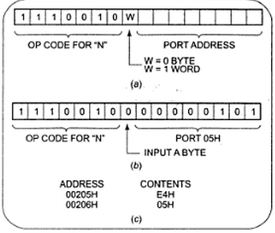
Instruction Template
The Intel literature shows two different formats for coding 8086 instructions.
Instruction templates helps you to code the instruction properly.
Example:
IN AL, 05H
CSE – 341 : Microprocessors
BRAC University

Slide 27
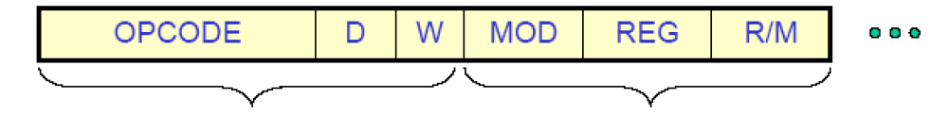
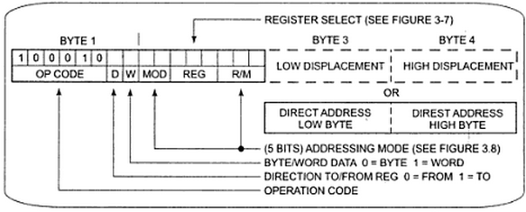
MOV Instruction Coding
MOV data from a register to a register or from a register to a memory location or from a memory location to a register. (Operation Code of MOV: 100010)
CSE – 341 : Microprocessors
BRAC University

Slide 28
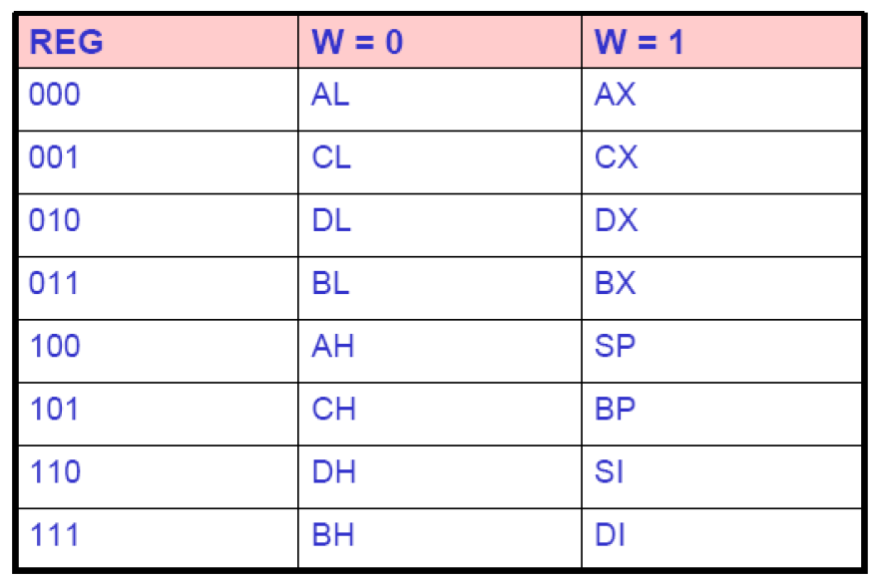
MOV Instruction Coding: REG Field
REG field is used to identify the register of the one operand
CSE – 341 : Microprocessors
BRAC University

Slide 29
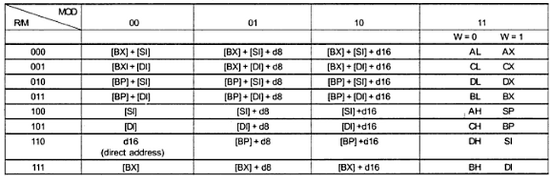
MOV Instruction Coding:
MOD and R/M Field
2-bit Mode (MOD) and 3-bit Register/Memory (R/M) fields specify the other operand.
Also specify the addressing mode.
CSE – 341 : Microprocessors
BRAC University

Slide 30
MOV Instruction Coding:
MOD and R/M Field
If the other operand in the instruction is also one of the eight register then put in 11 for MOD bits in the instruction code.
If the other operand is memory location, there are 24 ways of specifying how the execution unit should compute the effective address of the operand in the main memory.
If the effective address specified in the instruction contains displacement less than 256 along with the reference to the contents of the register then put in 01 as the MOD bits.
If the expression for the effective address contains a displacement which is too large to fit in 8 bits then out in 10 in MOD bits.
CSE – 341 : Microprocessors
BRAC University

Slide 31
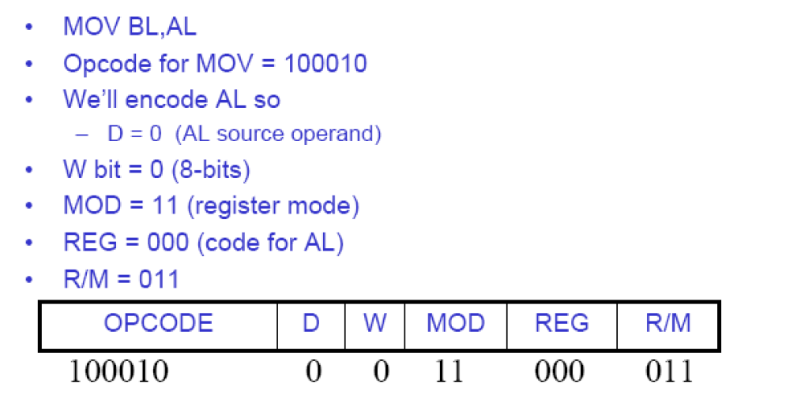
Example 1
CSE – 341 : Microprocessors
BRAC University

Slide 32
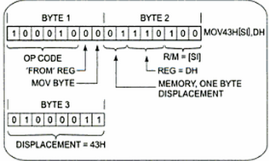
Example 2
MOV 43H [SI], DH: Copy a byte from DH register to memory location.
CSE – 341 : Microprocessors
BRAC University

Slide 33
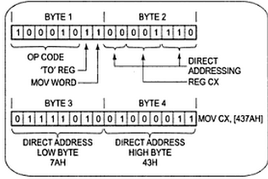
Example 3
MOV CX, [437AH]: Copy the contents of the two memory locations to the register CX.
CSE – 341 : Microprocessors
BRAC University

Slide 34
Thank You !!

